Slide 1

OBJECT DETECTION WITH YOLOV3
MUHAMMAD OSAMA
U41261655

Slide 2
What is YOLOV3?
FCN (Fully Convolutional Network)
One Stage Method.
Detections at 3 scales (13x13, 26x26, 52x52).
Makes 3 x (13x13 + 26x26 + 52x52) = 10647 bounding box predictions for each image.
Uses darknet 53 (very fast and performance comparable to Resnet) as the backbone for feature extraction.
Uses 3 anchor boxes at each scale.
3x3 and 1x1 convolutions, skip connections.
Multilabel classification.

Slide 3
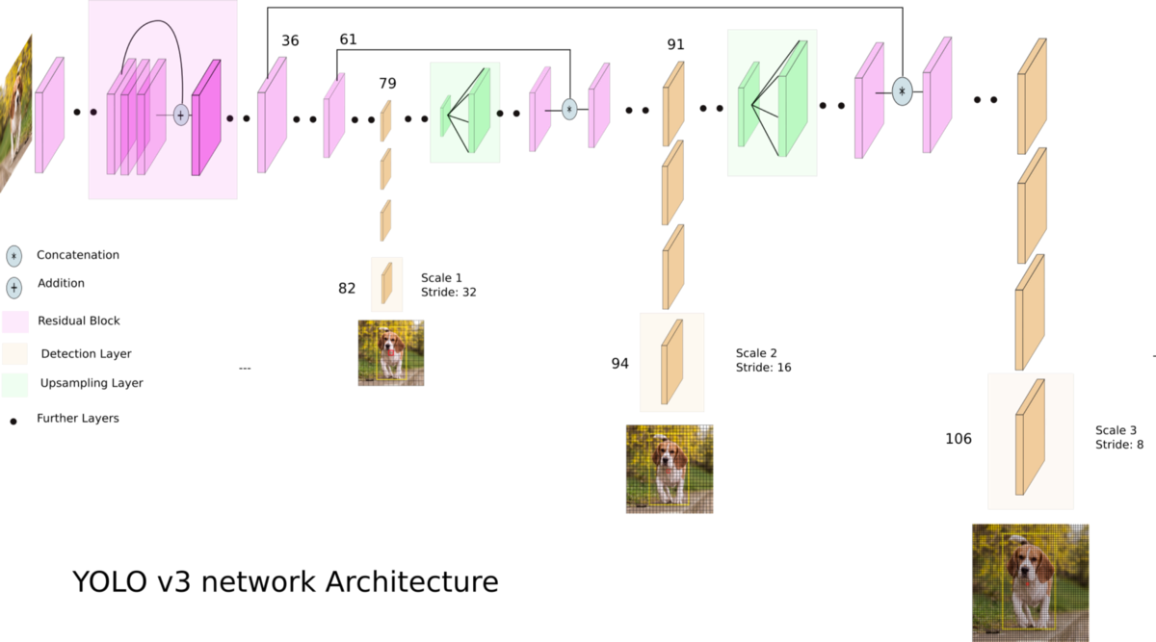
YOLOV3 Architecture

Slide 4
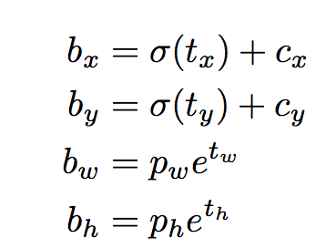
Anchor Box
YOLOV3 uses K-means to estimate the ideal bounding boxes.
Other methods involve learning the anchor box configuration as well.
These are basically log space transforms or offsets to original bounding boxes, using original leads to unstable gradients during training.

Slide 5
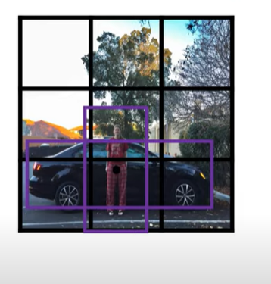
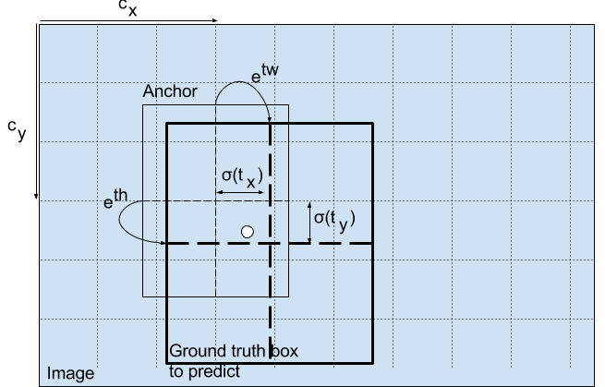
Anchor Box

Slide 6
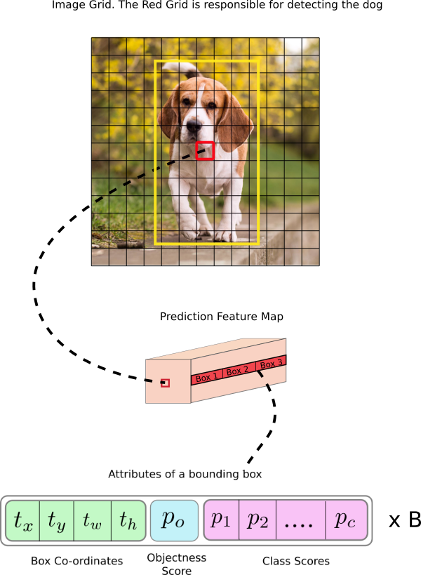
YOLOV3 Output

Slide 7
Implementation (Architecture)
Darknet 53 as the backbone.
Followed by Up sampling and Scaled predictions.
Total 75 Convolutional layers.
Output at 3 different scales (13x13, 26x26, 52x52), output shape is SxSx75.
Leaky ReLU Activation, padding = SAME, kernel initializer = he_normal, batch normalization (momentum = 0.9), ADAM optimizer.
Anchors used are the MS COCO dataset anchors defined in the research paper.

Slide 8
Implementation (Loss Function)
I compute 3 types of losses for each of the outputs which are:
Object Loss: Loss associated with an object being detected or not at a specific cell, the probability of an object being in the cell. Binary cross entropy is used for this. IOU is used as the objectness for the true labels.
Class Loss: This is cross entropy loss that the correct class is predicted.
Box Loss: This is mean squared error loss between the predicted and target bounding box coordinates.
The loss function is different for each of the outputs depending on the scaled anchors for each scale.

Slide 9
Implementation (Dataset)
The dataset used is the PASCAL VOC dataset from Kaggle.
Dataset already labelled and has 20 classes.
Dataset is loaded with batch size 32 using a data generator class that I created which inherits Keras Sequence class.
Albumentations library is used for resizing the images and return bounding box coordinates in yolo format.
The images are scaled by 255.
The target for the images is also set in the format of [object score, x, y, w, h, class]
No Loss incurred for other bounding boxes also detecting the same object with an IOU (intersection over union) of greater than 0.5.

Slide 10
Training & Testing
Training is done in a custom training loop.
Weights are saved for the model and the optimizer for each epoch.
The trained model is then used to make predictions on test set.
NMS (Non-Max Suppression) is performed on the predicted output.
mAP is calculated.

Slide 11
Improvements
Use images with different input sizes.
Allow for multi label classification. Each object detected can have one or more labels.

